Slide 1
COLUMBIA ASIA HOSPITAL

Slide 2
Problem Statement
You have been hired as a consultant data analyst by Columbia Asia Hospital. The Hospital is looking for the following key insights for the following objectives:
Assess the hospital's revenue generation
Insights about suitable departments for new hires
Strategies suggestions for patient discounts
Your task is to perform data analysis and come up with a report in order to help the organization with the mentioned objectives.

Slide 3
INTRODUCTION
We have analyzed the data about the Columbia Asia hospital, this document provides information about the hospital’s revenue and hiring new department, and we give some strategic ideas about patient discounts.

Slide 4
ANALYSIS
Patients discounts
Hiring new doctors for department
The hospital profitable or not profitable
Satisfaction score and wait time
Revenue generation
Department vs patients
Dashboard

Slide 5

KEY POINTS Total visits 9,216 Male visits 4,705 Female visits 4,487 Total revenue 509M Total doctors 22 Average satisfaction score 5.47 Average wait time 35.26

Slide 6
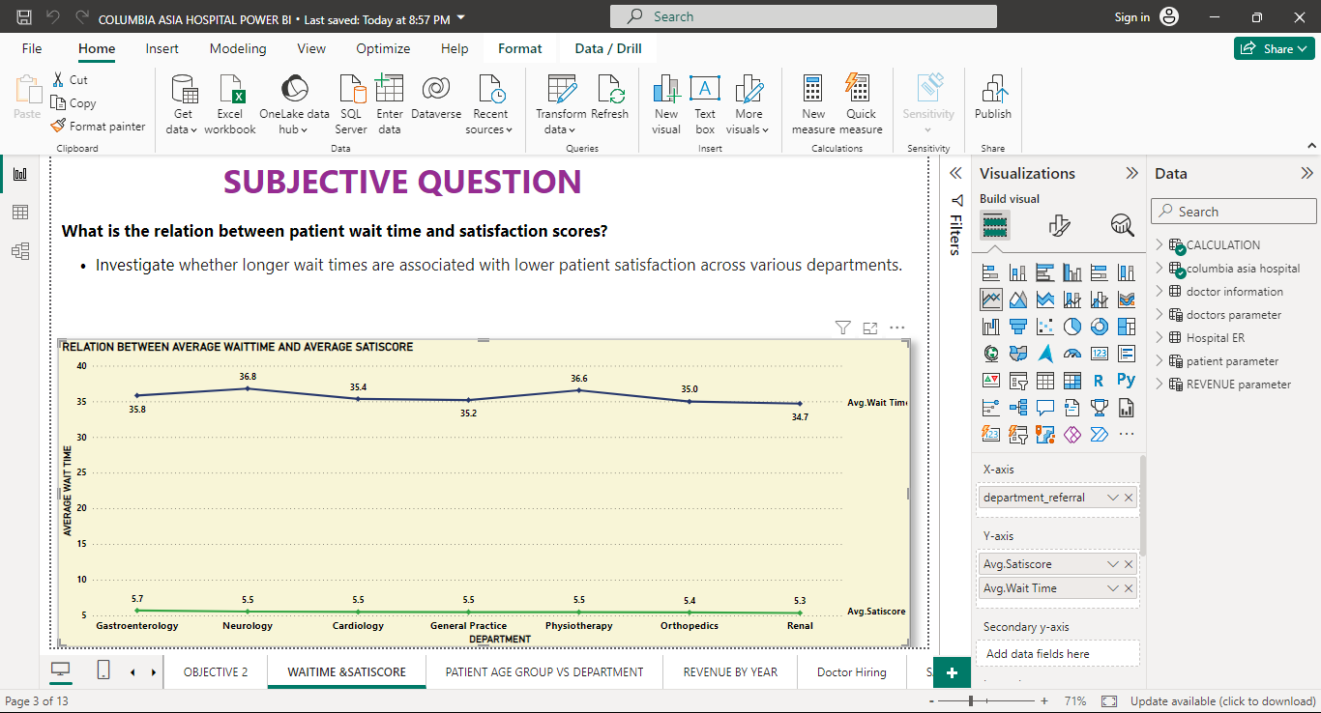
SUBJECTIVE QUESTION
RELATION BETWEEN AVG SAT SCORE AND AVG WAIT TIME
The avg sat score is depends on the avg wait time and health care service satisfaction.
Ave. wait time varies in physiotherapy(36.6), general practice(35.2), cardiology(35.4), neurology(36.8) department, the value of average satisfaction score value(5.5) is the same.

Slide 7
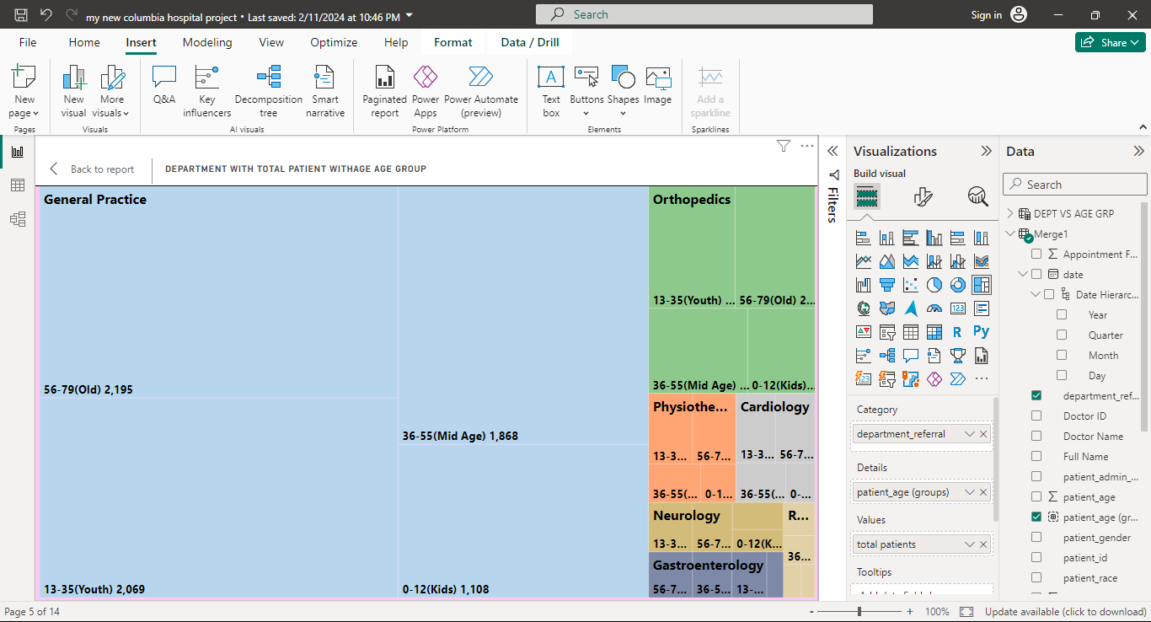
Frequently visits vs different age group patients
. Majority of youth and old patients have frequently visits to the General practice department .which is higher than kids and mid age

Slide 8
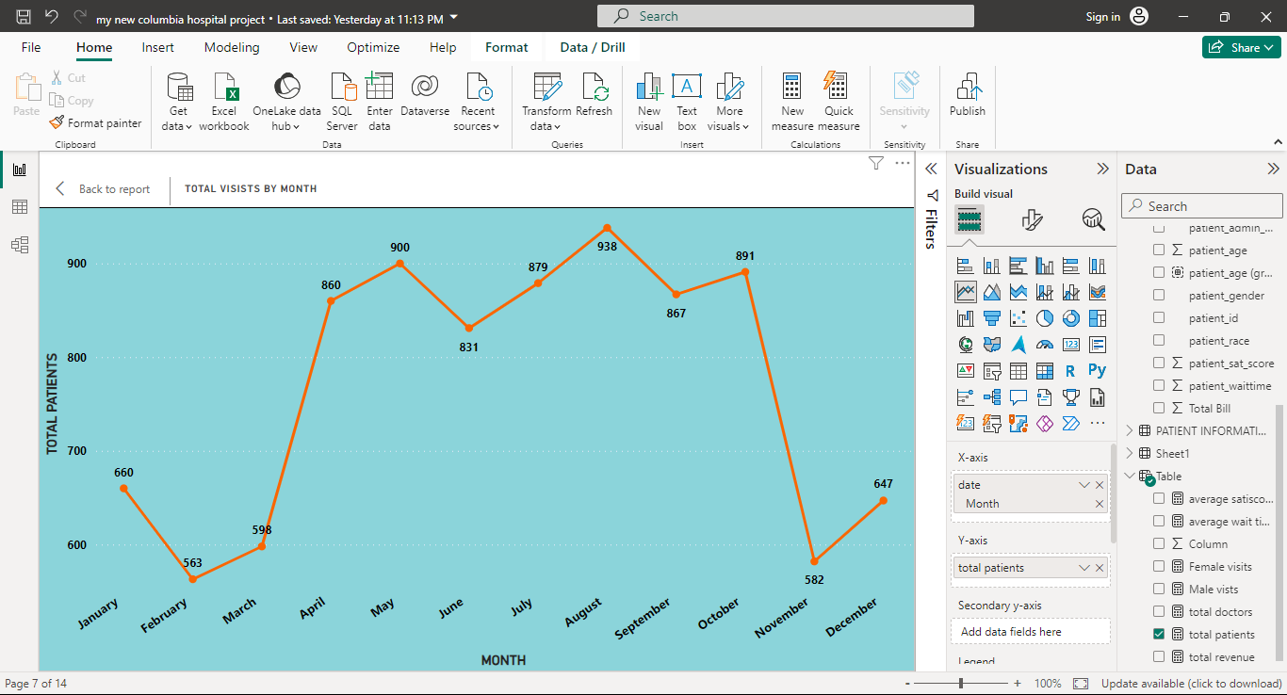
Patients visits by month
The patient demographic visits count increased in the month of august. And the patient count decreased in the month of February. 938 patients visited in the month of august, and 563 patients visited in the month February.

Slide 9
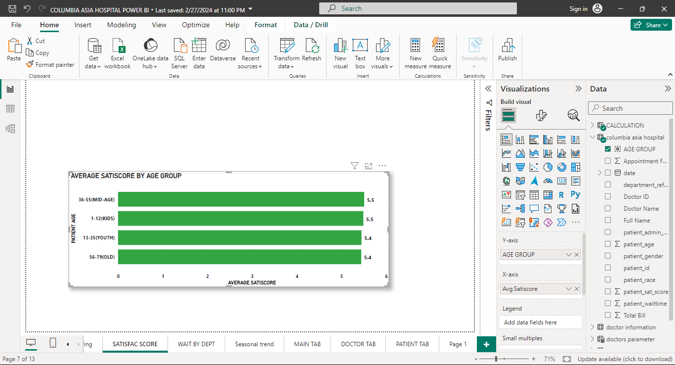
Age group vs highest sat score and lower sat score
The mid age(36-55) patients presented their best experience with the highest sat score of 5.51. The old (56-79) presented their least sat score of 5.44.

Slide 10

Strategies to provide discounts
FREQUENCY OF VISITS
FINANCIAL SITUATION OF PATIENTS
SEASONAL TRENDS
HEALTH
CARE NEEDS
PATIENT LOYALTY PROGREAM

Slide 11
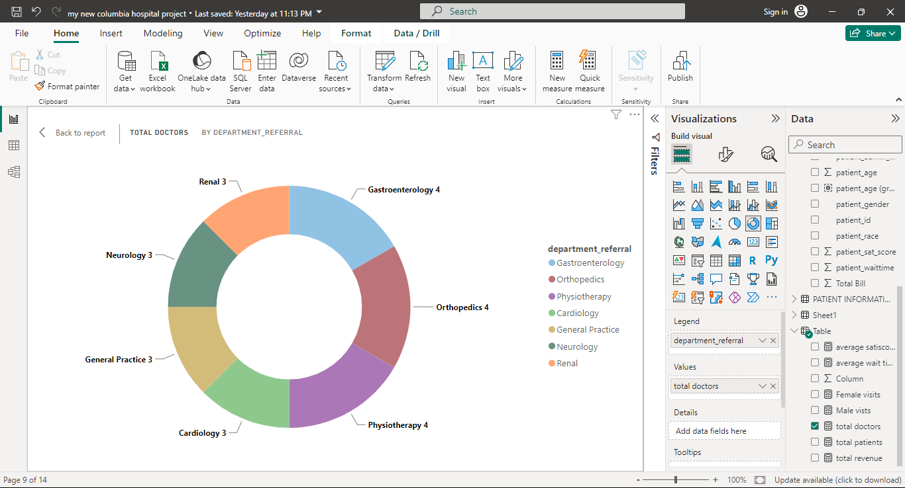
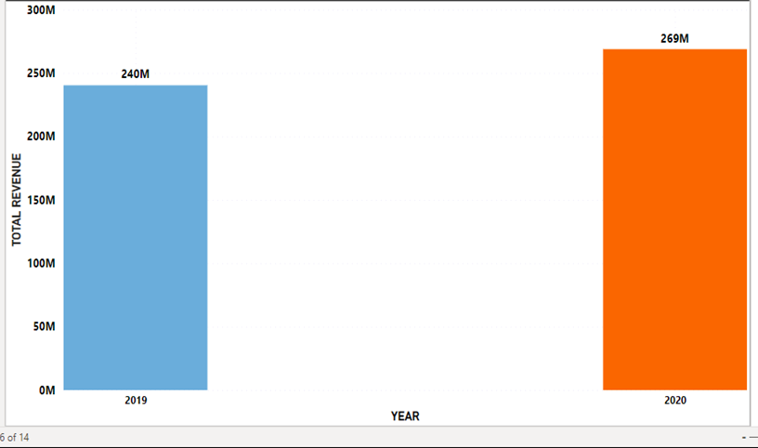
Hiring new doctors
We have Suggested the department of General Practice department . Because the Most patients Frequently visited the General practice department. The department needs more doctors for the Patients Good experience with the hospital.
Also consider the Orthopedics department, because the department generated the highest revenue to the hospital. It helps the hospital's Revenue generation.

Slide 12
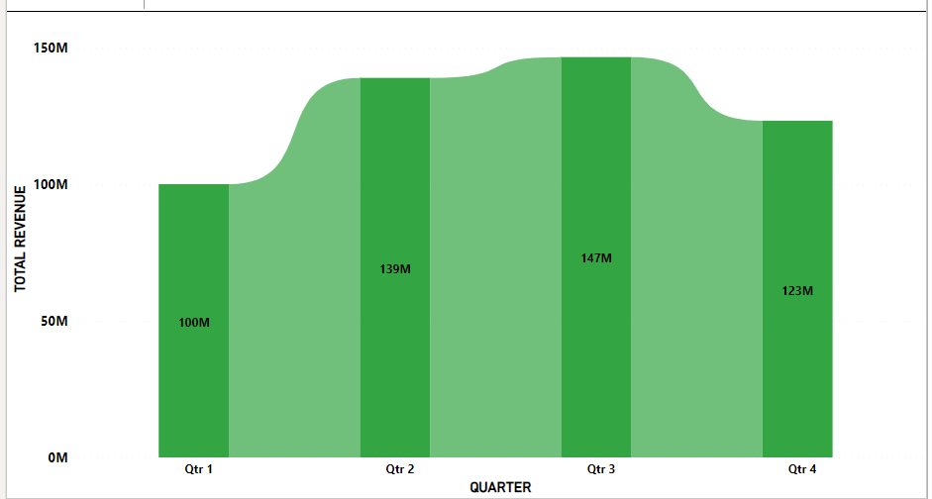
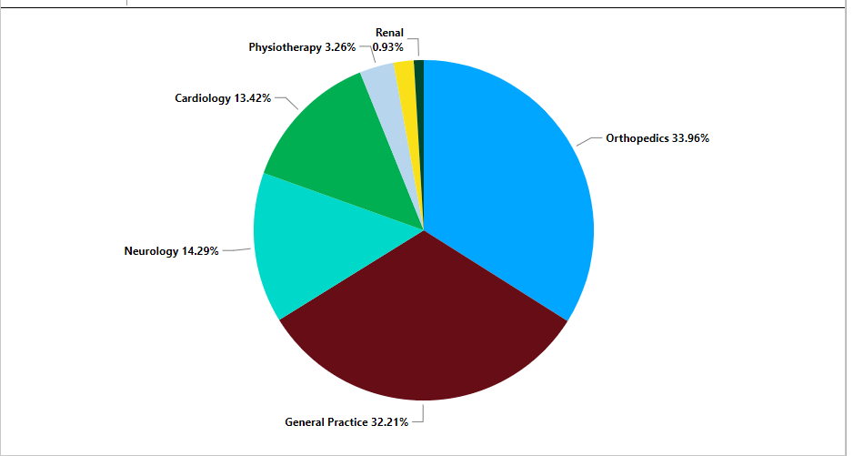
The hospital profitable or not profitable
The revenue trended down in the first quarter and 4 quarter. And it is increased in the 2nd quarter and 3rd quarter.
The orthopedics department generated the highest revenue of 33.96% to the hospital.

Slide 13
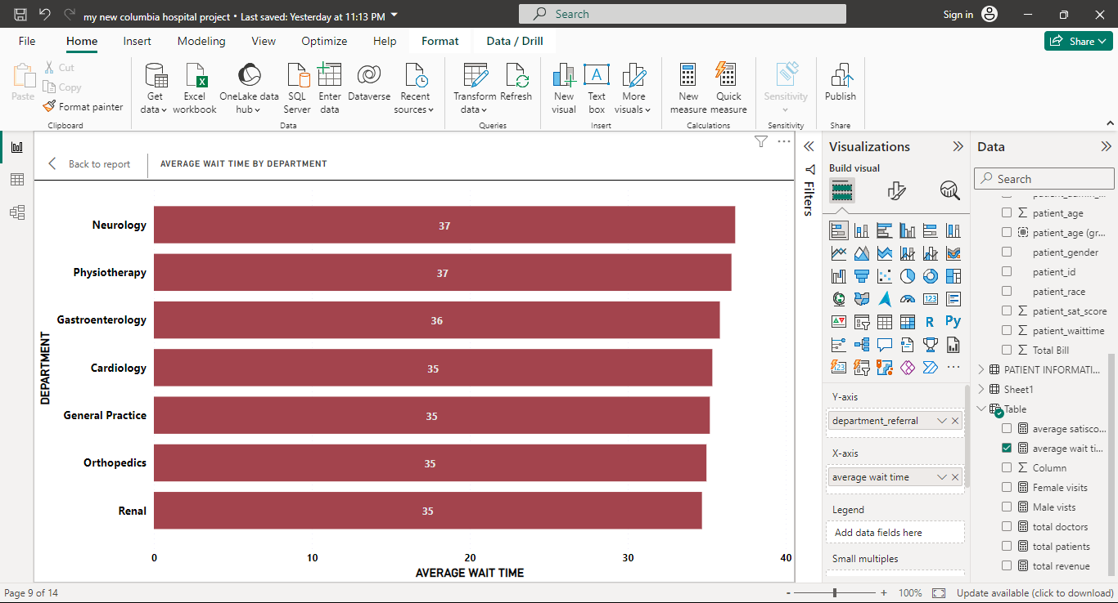
highest wait time and vs department
The maximum wait time of patients is 36.80 minutes and the department is Neurology.
The minimum wait time of patients is 34.70 minutes and the department is Renal.

Slide 14
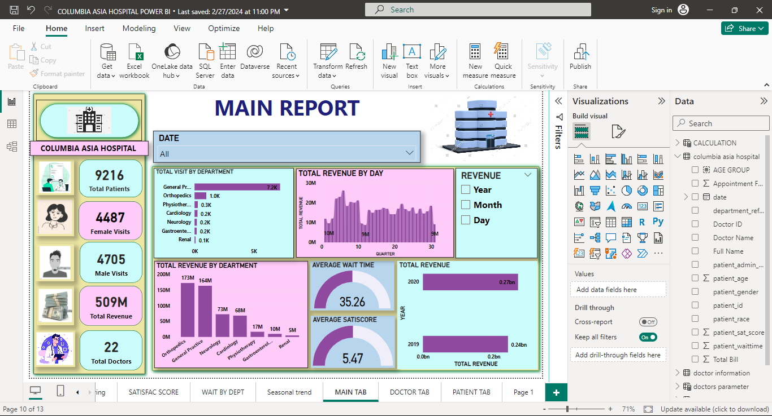
MAIN TAB

Slide 15
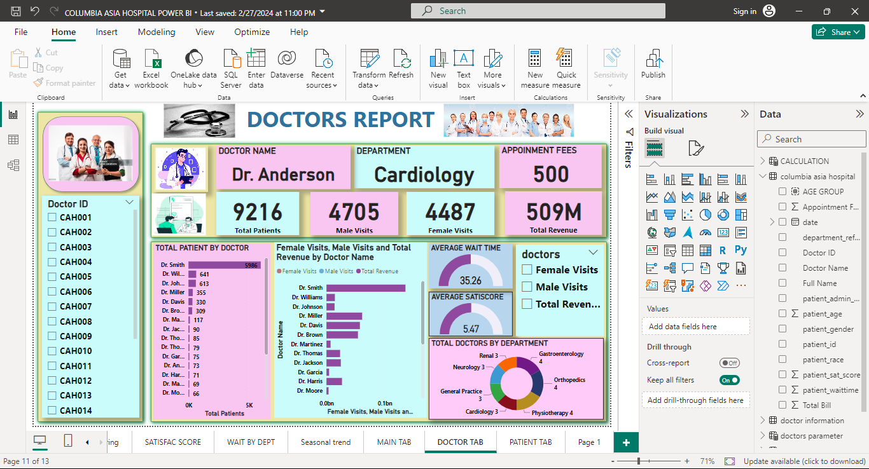
DOCTORS TAB

Slide 16
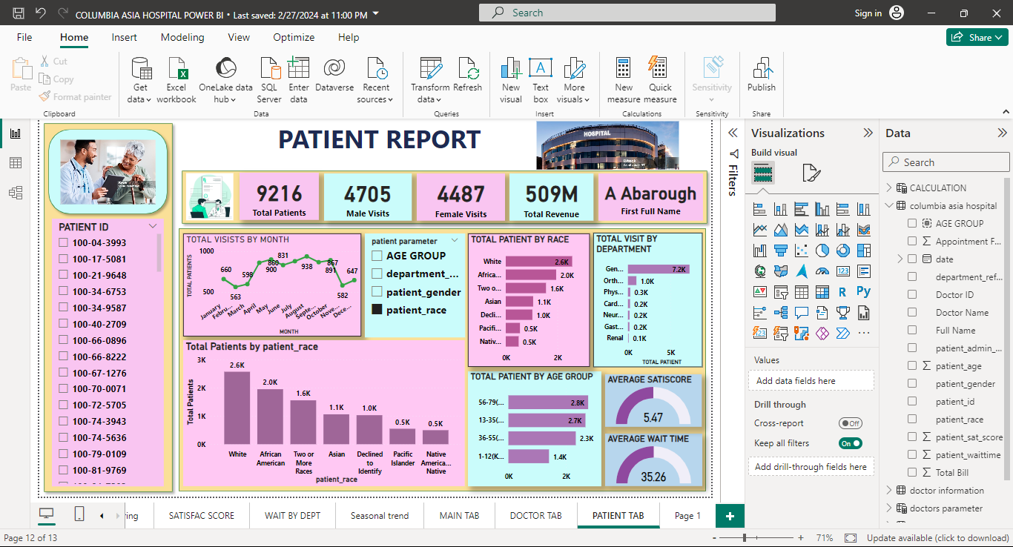
PATIENTS TAB

Slide 17
THANK YOU

